Slide 1






E-COMMERCE SALES ANALYSIS
Student Details
NAME: ELUMALAI A
NM ID: au62821105006
COLLEGE NAME: VARUVAN VADIVELAN INSTITUTE OF TECHNOLOGY

Slide 2
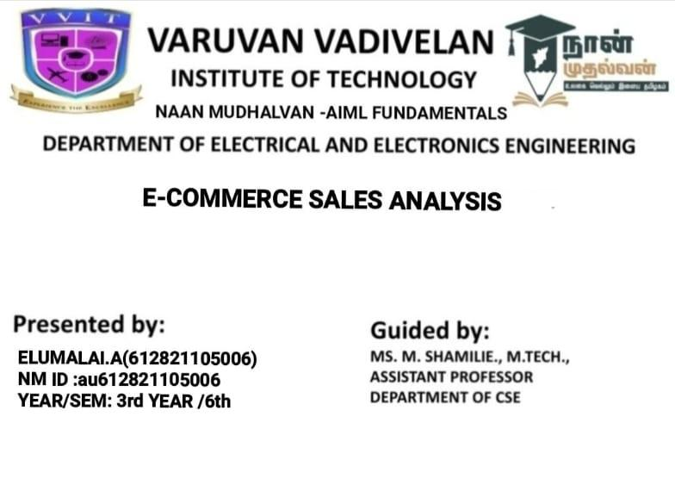

Slide 3
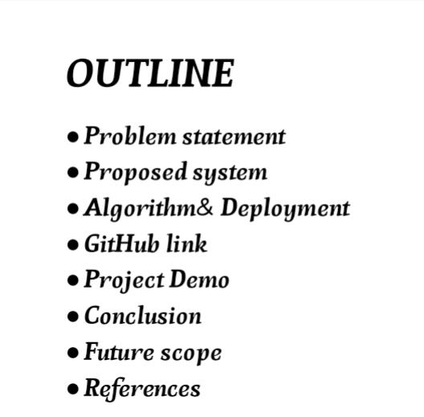


Slide 4
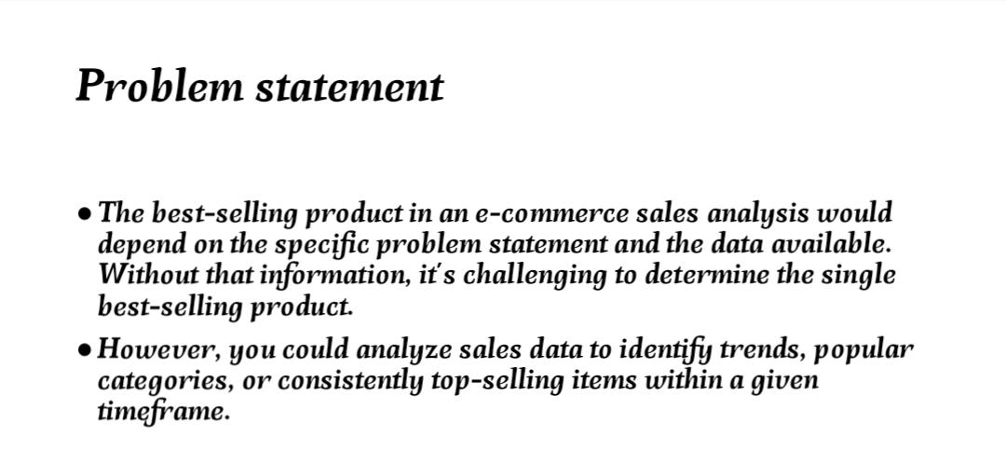



Slide 5
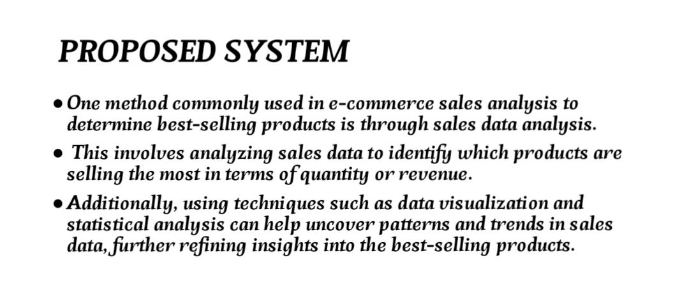



Slide 6
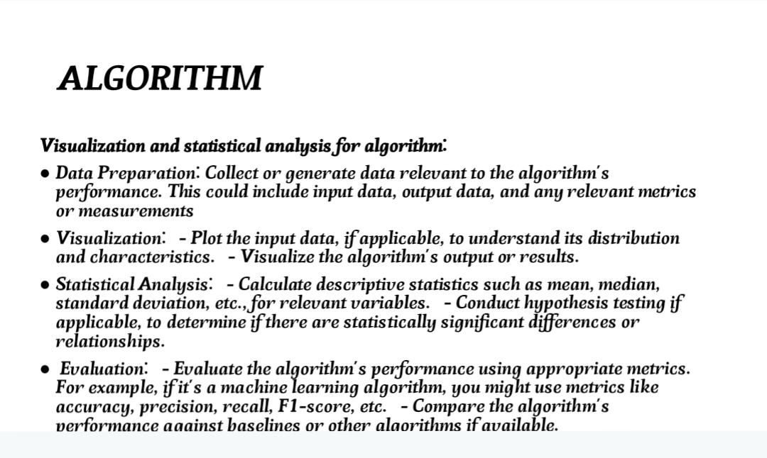

Aim and Objective

Slide 7
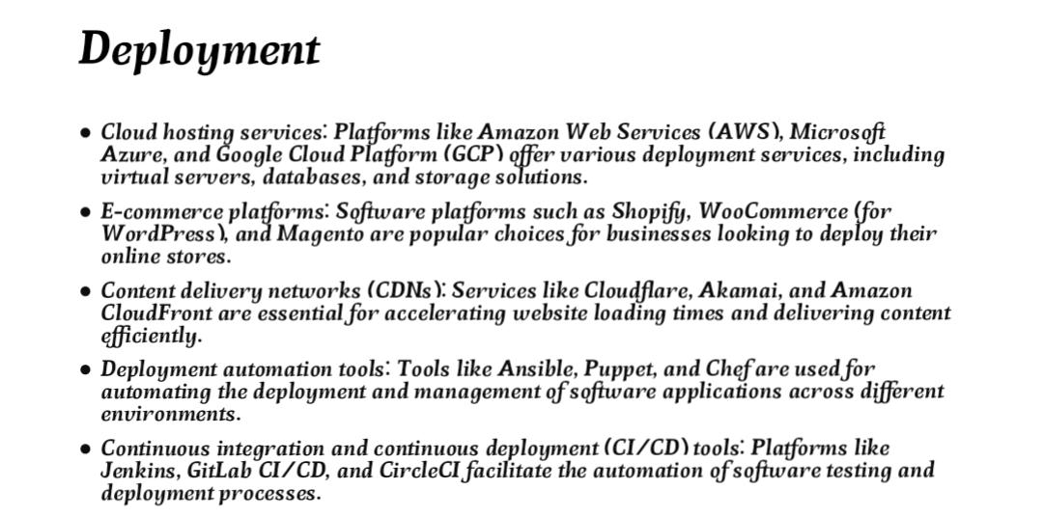

Slide 8
GITHUB LINK :
https://github.com/Elumani007
Notes:
8

Slide 9
PROJECT DEMO
https://github.com//Elumani007/Elumalai__E-commerce
Notes:
9

Slide 10
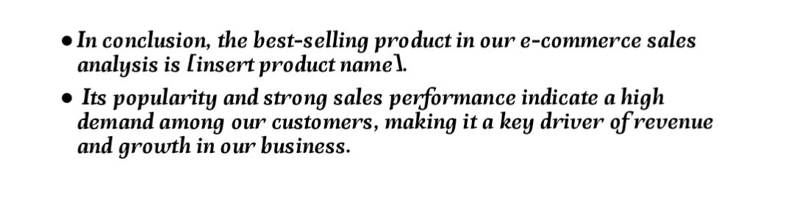

CONCLUSION :
Notes:
10

Slide 11

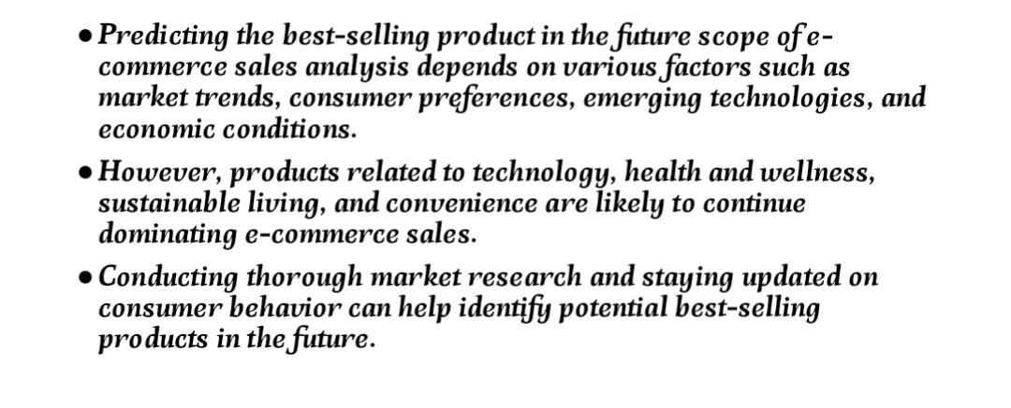
Future Scope
Notes:
11

Slide 12
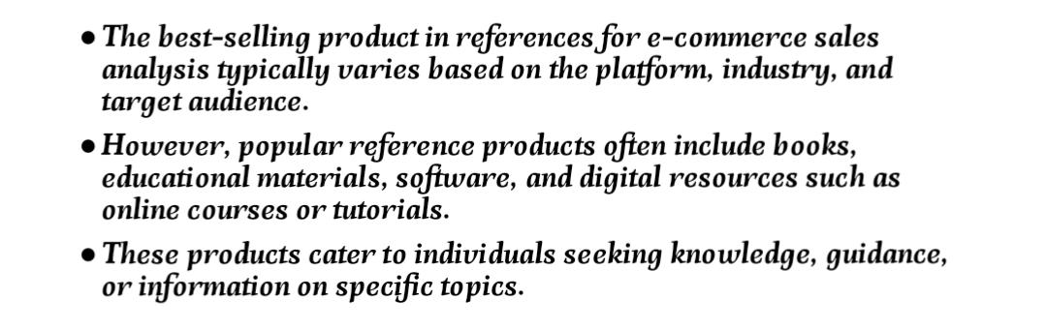
REFERENCS
Notes:
Reference
These are the references for this session.

Slide 13
Thank you!
Notes:
13

